Slide 1
Introduction to Kubernetes For Developers
Philly.NET Code Camp 2021
JvB, Consulting Architect, Rancher Federal

Slide 2




Jason van Brackel
jasonvanbrackel
@jvb
jasonvanbrackel

Slide 3
Objectives
Where To Start
Ask Questions

Slide 4
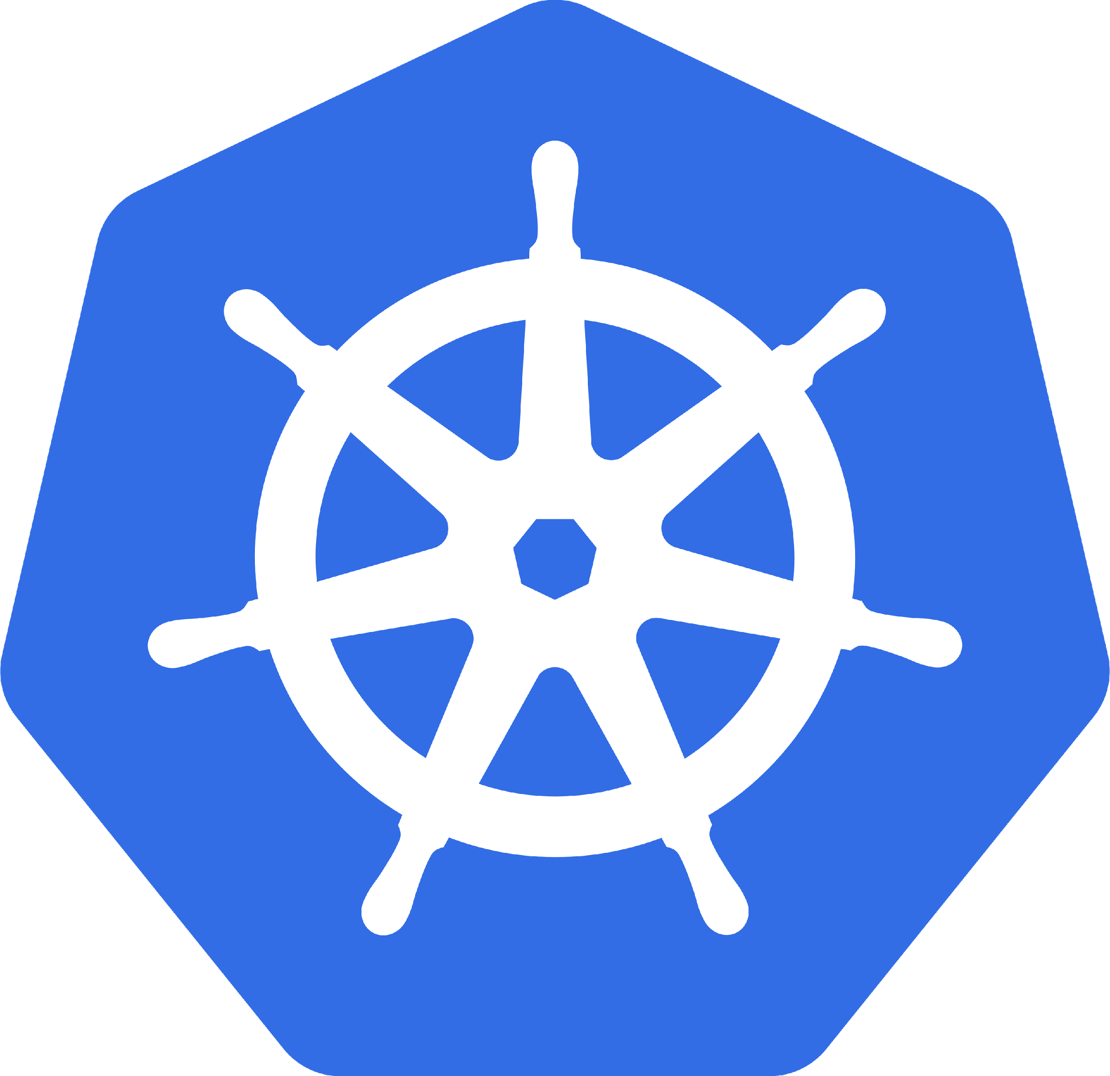
What is Kubernetes
Orchestrates Containers
That’s it? That’s all it does!

Slide 5
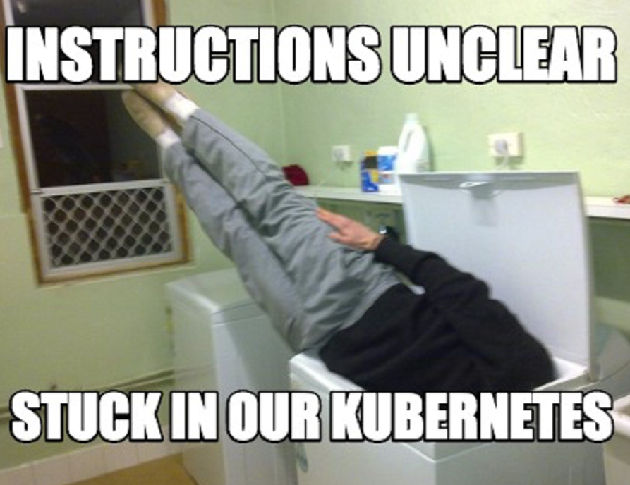
it IS Complex?
Scale
Kubernetes Reference API
What is Kubernetes Physically Speaking?

Slide 6
Why Should I care?
Developers
Operators
It Won !?!?

Slide 7

Why Should Developers care?
Containerized Applications
Breaking the Monolith
It’s the Substrate

Slide 8
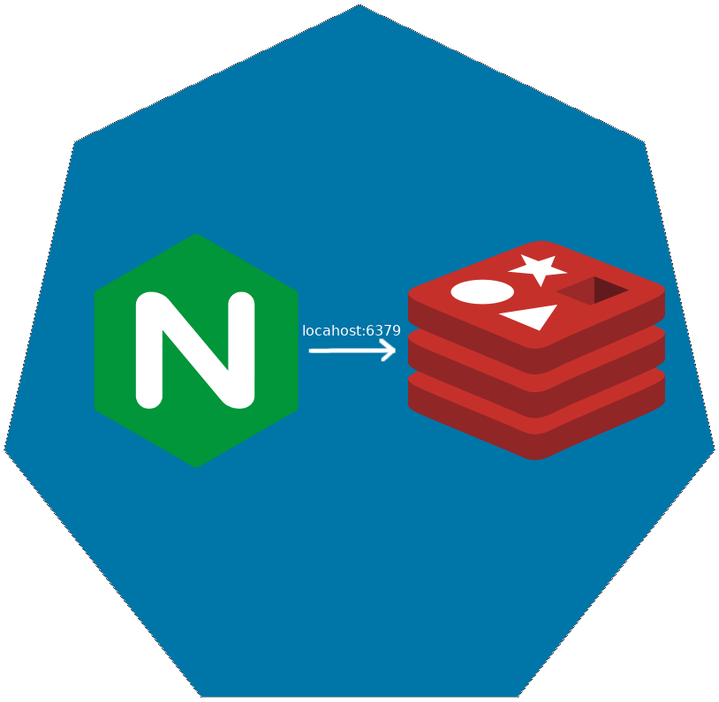
Pod
Co-scheduled
Shared Network Namespace
Shared Files System

Slide 9

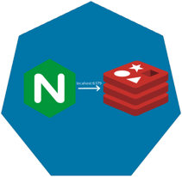
Replica SET

Slide 10

Replica SET

Slide 11
Replica SET

Slide 12
Deployments

Slide 13
Deployments

Slide 14
Deployments

Slide 15
Deployments

Slide 16
Deployments

Slide 17
Services
Define a DNS entry that can be used to refer to a group of pods
Provide a consistent endpoint for the group of pods
Different types: nodePort, clusterIP, loadbalancer
#rancherk8s

Slide 18


Services (Node Port)
192.168.0.[1-3]:32000

Slide 19
Services (Load Balancer)
Public IP:80

Slide 20
Config Maps & Secrets
Allow storing of arbitrary configuration values and files
Exposed in pods as either environment variables or as local storage
Decoupled storage of configuration from pod spec
#rancherk8s

Slide 21
Config Maps & Secrets
apiVersion: v1
kind: ConfigMap
metadata:
name: dev-config
namespace: default
data:
Item1: dev-stuff
Item2: more dev stuff
apiVersion: v1
kind: ConfigMap
metadata:
name: qa-config
namespace: default
data:
Item1: qa-stuff
Item2: more qa stuff
apiVersion: v1
kind: ConfigMap
metadata:
name: prod-config
namespace: default
data:
Item1: prod-stuff
Item2: more prod stuff

Slide 22
Ingresses
Define how traffic outside the cluster is routed to inside the cluster
Used to expose Kubernetes services to the world
Route traffic to internal services based on factors such as host and path
Ingress is usually implemented by a load balancer (Nginx, HAProxy, AWS ELB, etc…)
#rancherk8s

Slide 23

Ingresses
Ingress Controller
https://my-nginx-app.cluster.com https://cluster.com/my-nginx-app

Slide 24
